Slide 1
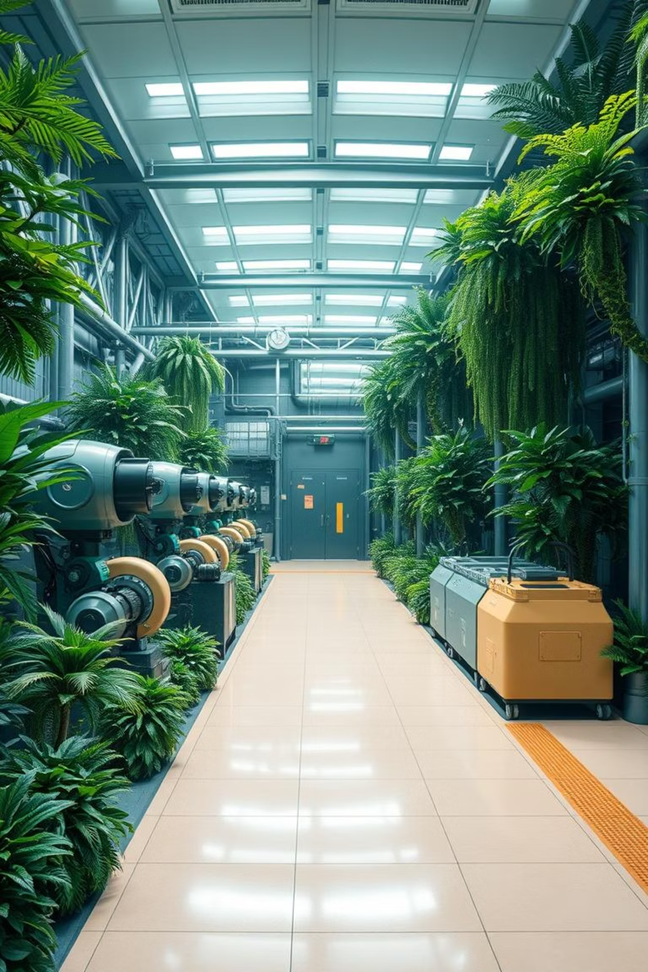

Cleantech: Transforming Waste Management with Transfer Learning
Revolutionising waste management for a sustainable India.
by Vineetha Paladugula

Slide 2
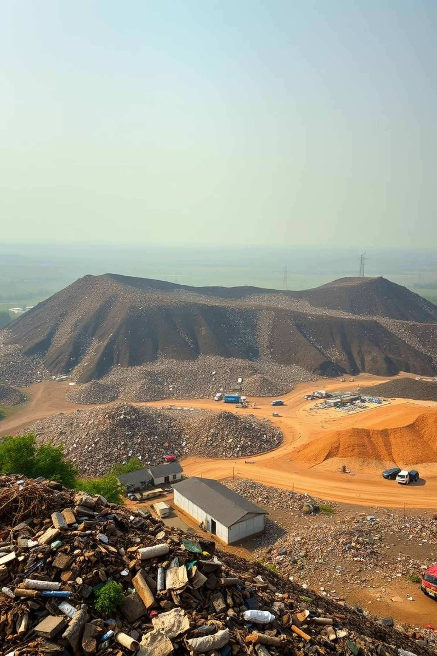
The Alarming Waste Challenge in India: A Pressing Concern
Mounting Waste
Health Hazards
India generates over 1.5 lakh metric tonnes of solid waste daily, a figure projected to double by 2030.
Unscientific waste disposal leads to severe health issues and environmental degradation.
Economic Burden
Inefficient waste management costs the economy significantly in lost resources and public health expenditures.

Slide 3
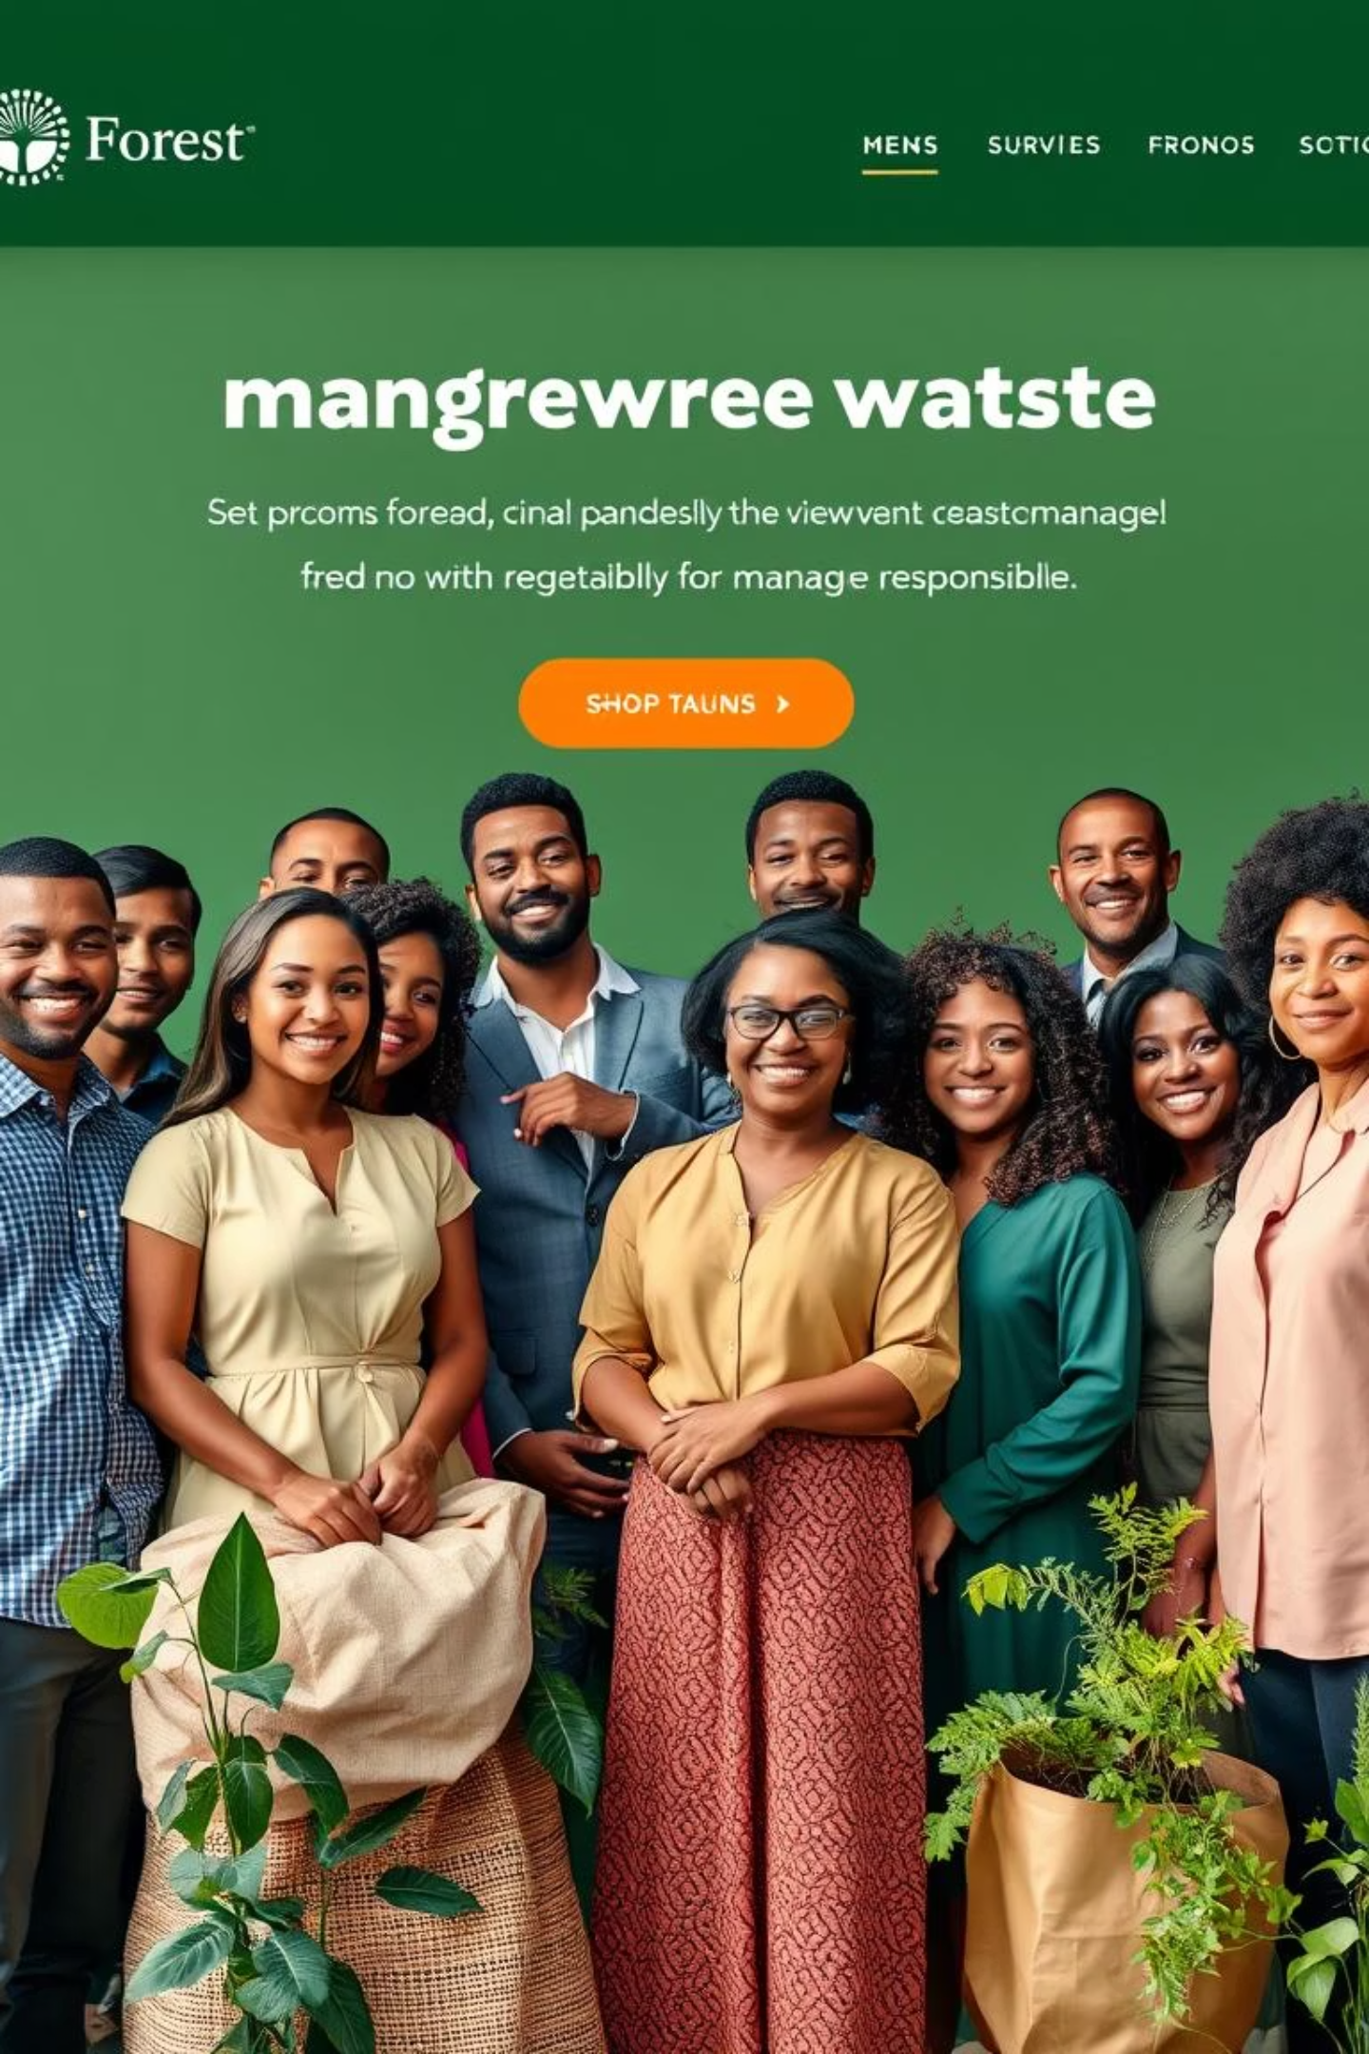
Cleantech's Vision: Sustainable Solutions for a Cleaner Tomorrow
Our mission is to create a circular economy where waste is a resource, not a burden.
Resource Recovery
Maximising material recovery and recycling to reduce landfill dependency.
Pollution Control
Implementing advanced technologies to minimise environmental pollution from waste.
Community Engagement
Fostering public participation for effective waste segregation and management.

Slide 4
Unpacking Transfer Learning: Leveraging Existing Intelligence for New Problems
Transfer learning empowers AI models to adapt prior knowledge to new, related tasks, dramatically improving efficiency.
Pre-trained Models
Fine-tuning
Utilising models trained on vast datasets, like ImageNet, for foundational knowledge.
Adapting these models with smaller, specific waste-related datasets for precision.

Slide 5
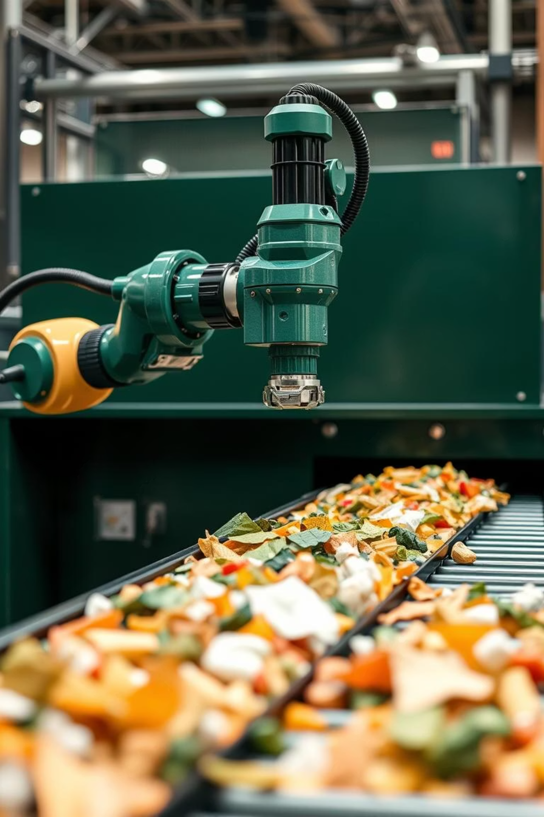




Intelligent Waste Segregation: How Transfer Learning Fuels Efficiency
Image Capture
High-resolution cameras capture images of mixed waste.
AI Processing
Transfer learning models rapidly identify waste categories (e.g., plastic, organic, metal).
Automated Sorting
Robotic systems precisely segregate waste based on AI analysis.
Data Insights
Continuous learning refines accuracy and identifies waste patterns for optimisation.

Slide 6
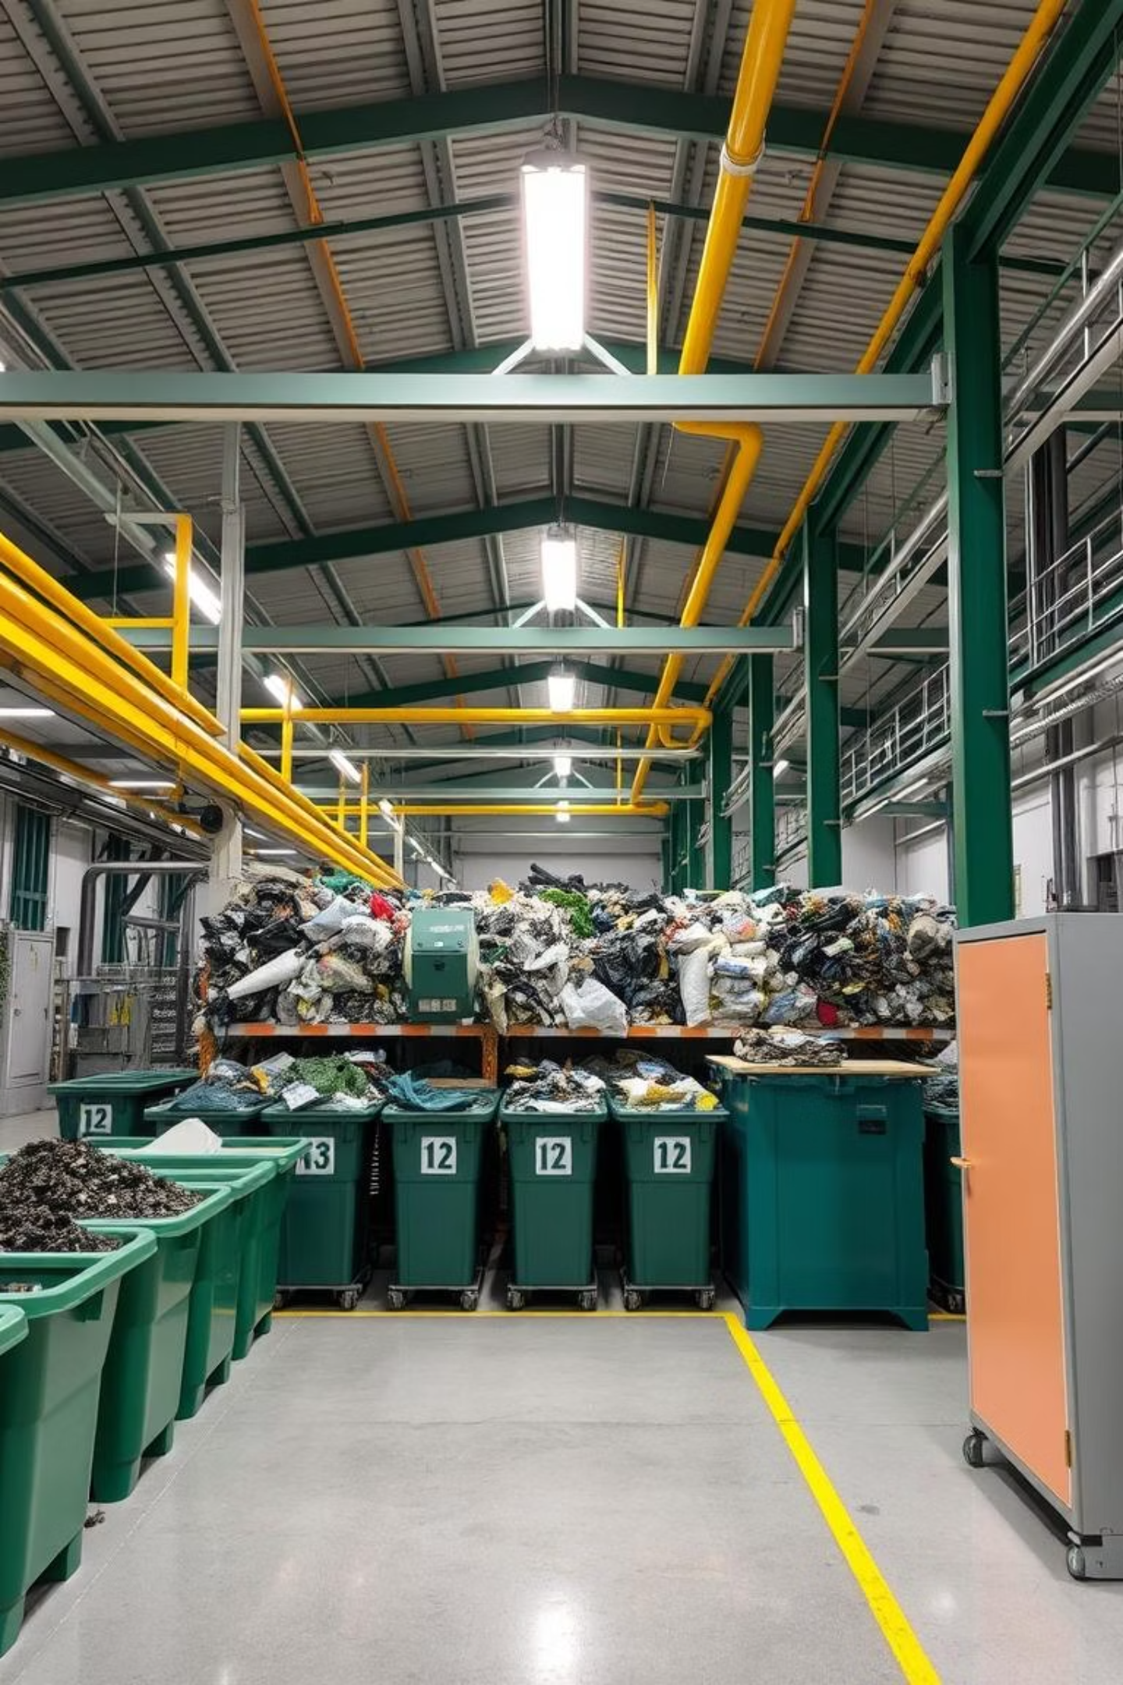
Impactful Innovations: Case Studies from India's Waste Management Sector
60%
25%
₹50L
Segregation Efficiency
Recyclable Recovery
Cost Savings
Annual operational savings for a municipal waste plant in Mumbai through automation.
Achieved in a pilot project in Bengaluru, reducing manual sorting time significantly.
Increase in recovery rates for plastics and paper in Delhi, boosting circular economy efforts.

Slide 7
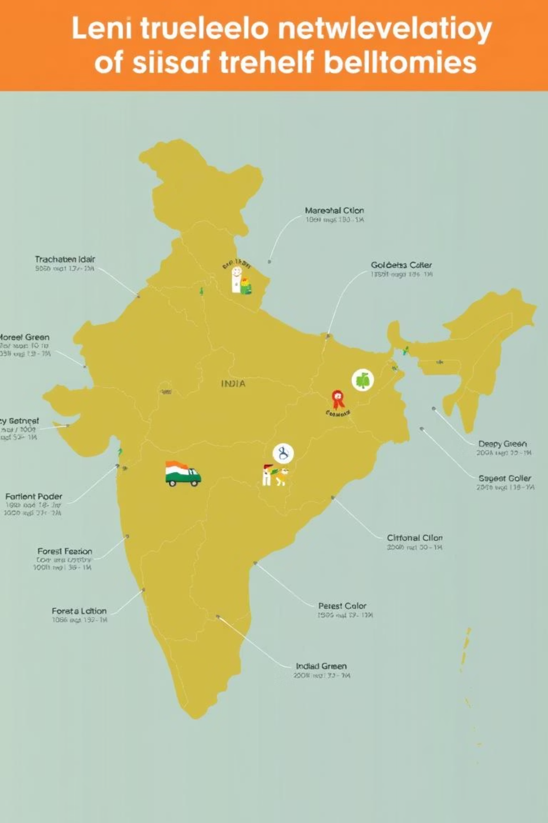
Scaling Up: Challenges and Opportunities for Widespread Adoption
1
Funding & Investment
Securing capital for infrastructure development and technology deployment.
2
Policy & Regulations
Developing supportive governmental policies and regulatory frameworks.
3
Skill Development
Training a skilled workforce to operate and maintain advanced waste management systems.
4
Public Awareness
Enhancing community participation through sustained awareness campaigns.

Slide 8






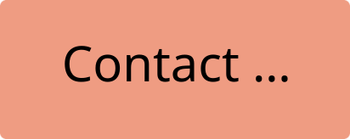

Paving the Way Forward: Key Takeaways and Our Collective Responsibility
Collaboration is Critical
Partnerships between government, industry, and citizens are vital.
Innovation is Key
Embracing advanced technologies like transfer learning is crucial.
Sustainability is the Goal
Working towards a cleaner, healthier, and more resource-efficient India.

